Slide 1
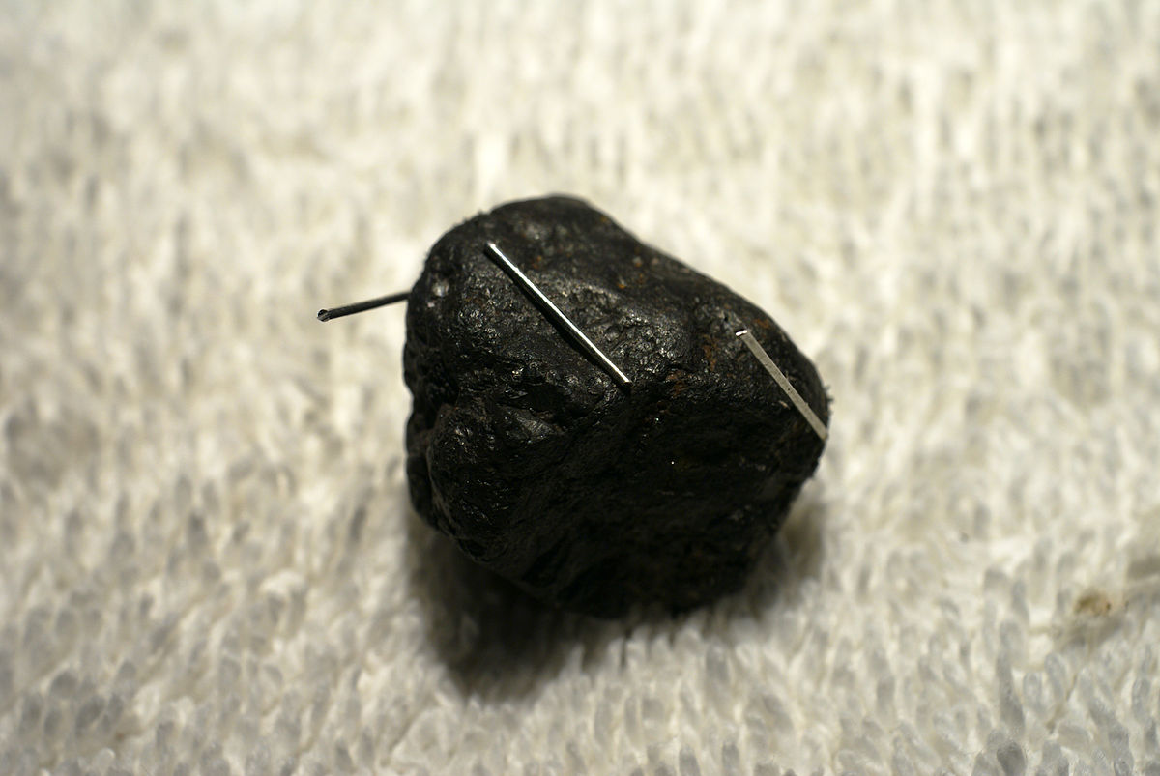
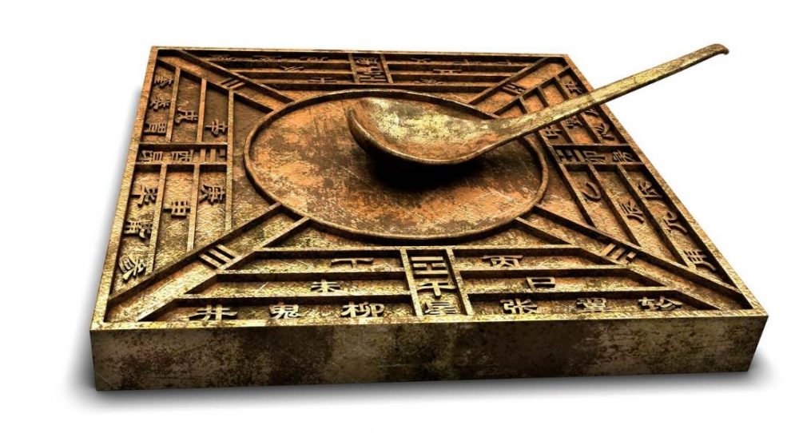
How Did This All Start?
Earlier than 600 BCE the Greeks noticed that Lodestone would attract other lodestones and iron. They later noticed similar properties with Amber when they rubbed it with certain materials.
The classical names for amber are electrum (Latin) and ἤλεκτρον or ēlektron (Ancient Greek). These gave rise to the word “Electron” because of ambers ability to hold static electricity.
Lodestones are pieces of mineral magnetite that have been naturally magnetized.
The Chinese also knew of the magnetic properties of Lodestone as early as 400 BCE. By the 12th century they were using lodestone compasses to navigate.
A piece of lodestone attracting nails.
The original Chinese compass was also used as a device to help you harmonize with the environment as a part of feng shui.
Notes:
Another photo original look of compass?
Notes on images so we can understand all the stuff – caption
Could lead into the existing slides?
Look into other uses they had for amber??? And maybe other things????
Make slides that separate the material into the weeks they are supposed to fit into just to make sure everything Is clear.

Slide 2
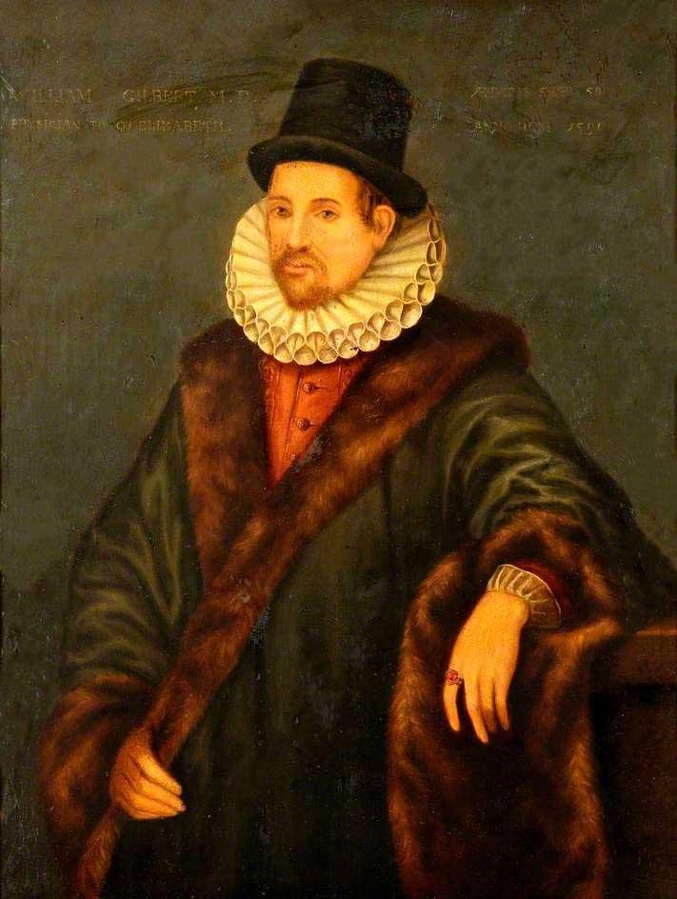
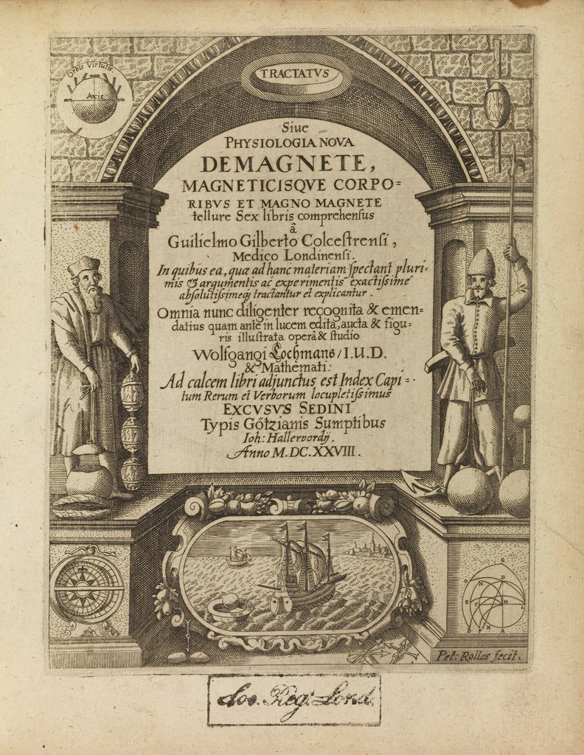
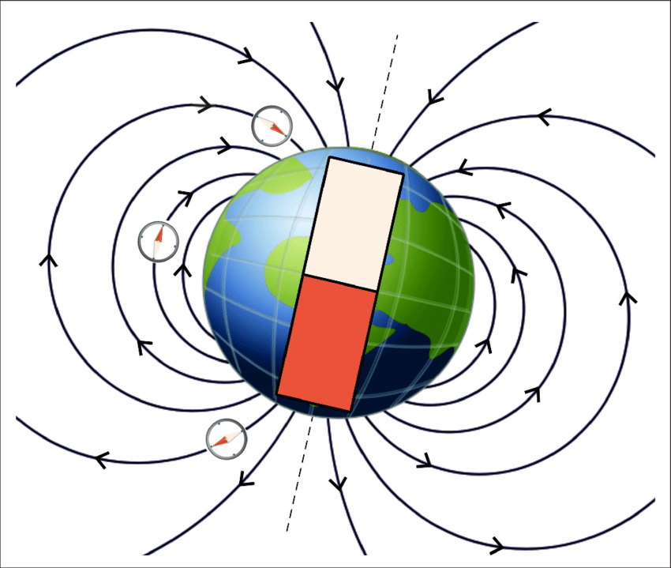
The Beginnings of Research.
Research on why lodestones and other magnetic materials behaved in these ways did not start until the 17th century.
William Gilbert investigated why magnetic compasses pointed north and published his findings in “De Magnete, Magneticisique Corporibus” (On the Magnet).
He argued that compasses pointed north because the earth was a giant magnet with an iron core instead of it being because of the north star or a magnetic island in the north.
Later, this spurred Carl Friedrich Gauss to do his own theoretical investigations into the earth’s magnetic properties.
A portrait of William Gilbert, a physician to Queen Elizabeth the 1st.
The cover of his published research
Notes:
Talk about the going theories at the time before this research of why compasses behaved the way they did.
Have had so many aurora activities? – Could relate this to the aurora that’s been really active recently and how this shows the magnetic field of the earth?

Slide 3



Seeing the Earths Magnetic field!
Aurora Borealis In Calgary

Slide 4
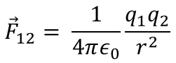
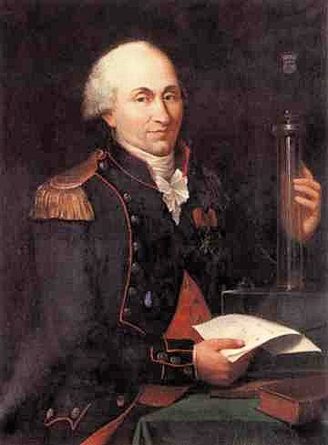
Charles Coulomb
A French Physicist of whom the unit of charge, the Coulomb, is named after.
The first to determine how charged particles react to one another.
Believed that electricity was due to fluids that could permeate matter. One fluid being Positive or Vitreous and the other Negative or Resinous .
He did not find any relationship between magnetism and electricity, although he separately explained repulsion and attraction for both phenomena.
Vitreous (+)
Resinous (-)
When the Vitreous and Resinous fluids were in balance the material would be neutral.
A portrait of Charles Coulomb
Notes:
Maybe talk a little more about the theories of the time?
Identifying key stories for week 1.

Slide 5
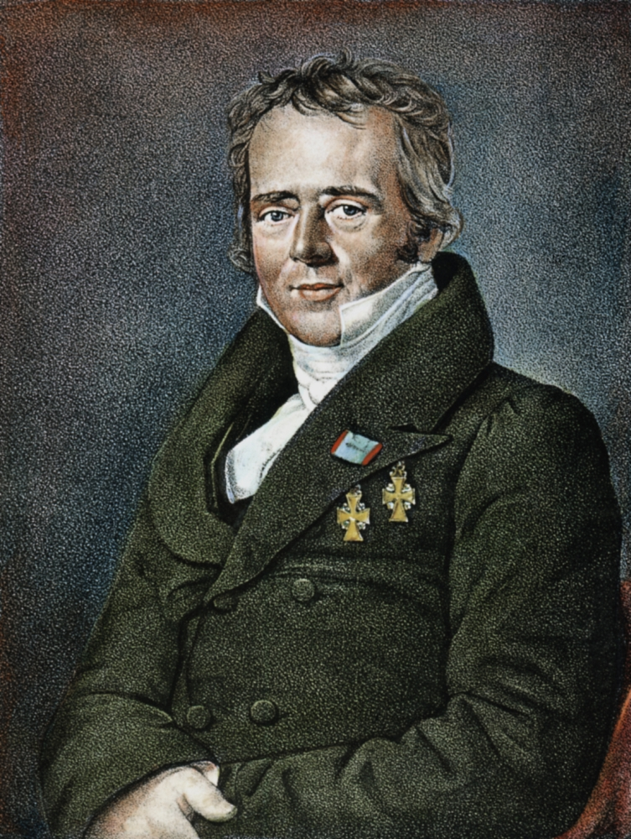
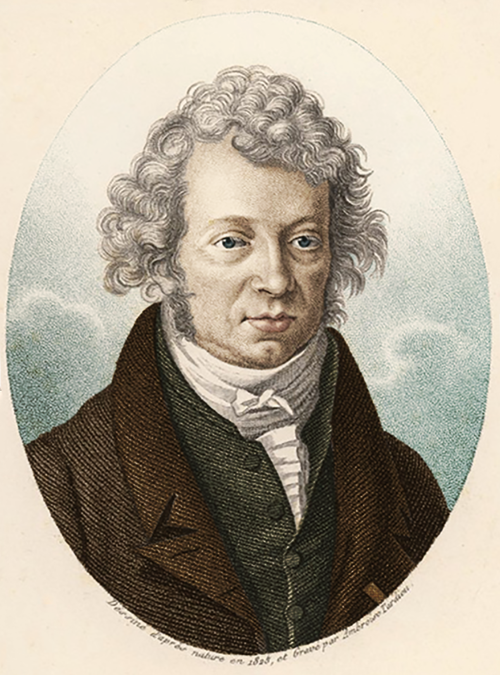
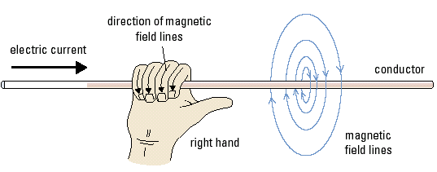
Electromagnetism
The connection between electricity and magnetism wasn’t discovered until Hans Christian Oersted discovered that an electric current could influence a compass needle.
Following this discovery, André-Marie Ampère began his own research into Electromagnetism and showed that a current carrying wire would generate a magnetic field proportional to the current passing through the wire.
Hans Christian Oersted, who was the first to notice the relationship between electricity and magnetism.
André-Marie Ampère
Diagram showing the relationship between electric current and magnetic field.
Notes:
Faraday – bookbinders assistant – didn’t have good education – at night he read the books and that is how he learned about the science and do the experiments. Add stuff since it is so unique.

Slide 6
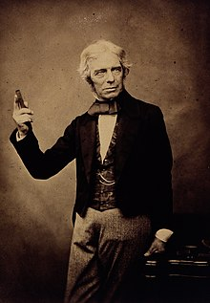
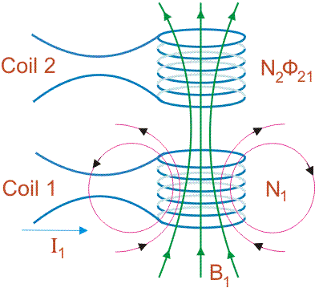
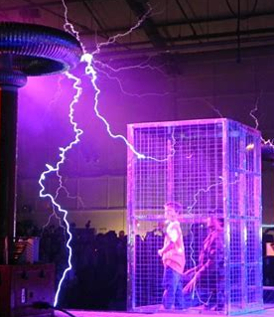
Michael Faraday
Michael Faraday
Unlike most other scientists at the time, he did not come from a wealthy family and receive a good education
He only had the most basic school education but taught a lot to himself by reading the books he would bind as he worked as a bookbinder.
He created the first electromagnetic motor along with discovering electromagnetic induction.
He discovered mutual inductance which is expressed by one of maxwells equations named “Faraday’s Law”.
He also created the well known “Faraday cage” that shields anything inside of it from electricity.
Mutual Inductance is the phenomena in which a changing current in one coil induces an emf in another coil.
A Faraday cage in action

Slide 7
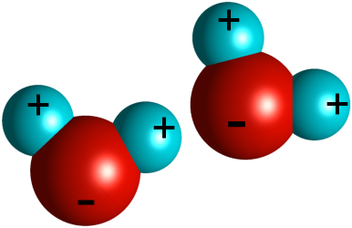
How Coulombs Law Impacts Molecular Properties
Elements and Molecules have either positive, negative or neutral charge.
Charges interact strongly when they are nearby and cause many properties within and between materials.
Water has a permanent dipole due to the Electronegativity of the oxygen molecule.
A stronger Electronegativity is partially due to how coulombs law attracts opposite charge.
Notes:
Model water as a dipole and have a problem about coloumb law interaction between dipoles?
Maybe a little bti more to connect how electronegativity is related. Possible picture of showing the electrons more around the oxygen. Electron cloud?
Bring up the example of how water bends when near a charged rod.
Work along problem 02-01 – relate to how water bends when near a charge. – moreso make it two water molecules and
Could make a new problem about the electric field of a water molecule modeled as a dipole.
Model water as two dipoles? – if so, we would want to only go qualitative problems.
1 or 2 clicker type conceptual questions would be best about how the field around water interacts with other charged particles and then its fluid properties.
Get a new picture to more clearly show dipole stuff?
Maybe change this slide? To be more basic and jut about coulombs law and charged particles? Then make all the water stuff on the other slide? Then could do a problem just qualitative on coloumbs law and molecular properties?
Maybe talking historically about friction and electrical properties? - even though it is the first one and far from the end survey.

Slide 8
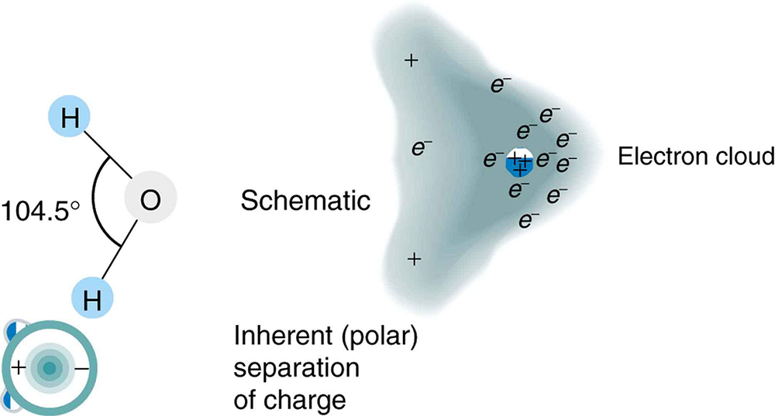
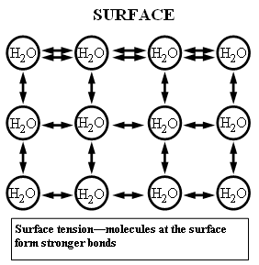
How Coulombs Law Impacts Molecular Properties
The positive charge on the Hydrogen molecules comes from the uneven distribution of electrons as oxygen pulls them towards itself.
The dipole nature of water causes it to have a high surface tension. The molecules on the surface create stronger bonds because there aren’t dipoles above them to attract other molecules.
This diagram shows how the electron cloud distribution in the water molecule has a much higher probability of having electrons near the oxygen molecule than the hydrogens.
Notes:
Model water as a dipole and have a problem about coloumb law interaction between dipoles?
Maybe a little bti more to connect how electronegativity is related. Possible picture of showing the electrons more around the oxygen. Electron cloud?
Bring up the example of how water bends when near a charged rod.
Work along problem 02-01 – relate to how water bends when near a charge. – moreso make it two water molecules and
Could make a new problem about the electric field of a water molecule modeled as a dipole.
Model water as two dipoles? – if so, we would want to only go qualitative problems.
1 or 2 clicker type conceptual questions would be best about how the field around water interacts with other charged particles and then its fluid properties.

Slide 9
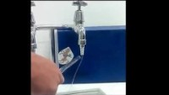
How Coulombs Law Impacts Molecular Properties
The dipole nature of water also causes interesting interactions with charges!
Notes:
Model water as a dipole and have a problem about coloumb law interaction between dipoles?
Maybe a little bti more to connect how electronegativity is related. Possible picture of showing the electrons more around the oxygen. Electron cloud?
Bring up the example of how water bends when near a charged rod.
Work along problem 02-01 – relate to how water bends when near a charge. – moreso make it two water molecules and
Could make a new problem about the electric field of a water molecule modeled as a dipole.
Model water as two dipoles? – if so, we would want to only go qualitative problems.
1 or 2 clicker type conceptual questions would be best about how the field around water interacts with other charged particles and then its fluid properties.

Slide 10
Additional Resources
More on surface tension:
https://www.usgs.gov/special-topic/water-science-school/science/surface-tension-and-water?qt-science_center_objects=0#qt-science_center_objects
More on dipole-dipole interactions:
https://courses.lumenlearning.com/boundless-chemistry/chapter/intermolecular-forces/

Slide 11
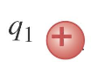
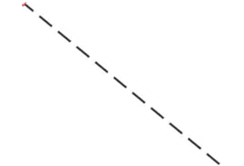
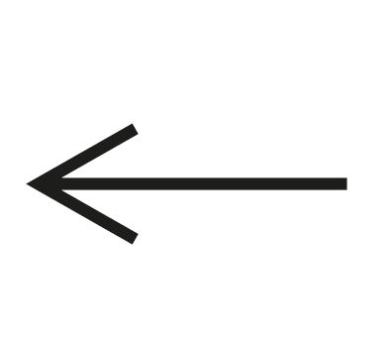
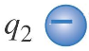
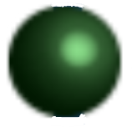
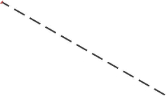
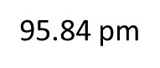

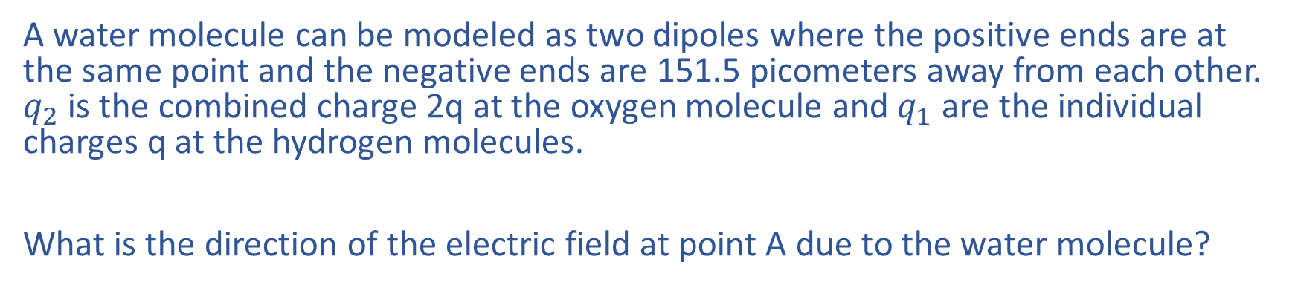
Dipole Electric Fields, Part 1
A water molecule can be modeled as two dipoles where the positive ends are at the same point and the negative ends are 151.5 picometers away from each other. $q_{2}$ is the combined charge 2q at the oxygen molecule and $q_{1}$ are the individual charges q at the hydrogen molecules.
What is the direction of the electric field at point A due to the water molecule?
Up
Down
Left
Right
Zero
95.84 pm
151.5 pm
A

Slide 12
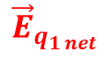
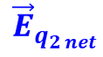
Dipole Electric Fields, Part 1
A water molecule can be modeled as two dipoles where the positive ends are at the same point and the negative ends are 151.5 picometers away from each other. $q_{2}$ is the combined charge 2q at the oxygen molecule and $q_{1}$ are the individual charges q at the hydrogen molecules.
What is the direction of the electric field at point A due to the water molecule?
Up
Down
Left
Right
Zero
95.84 pm
151.5 pm
$${\vec{E}}_{q_{2 net}}$$
A
A
$${\vec{E}}_{q_{1 net}}$$

Slide 13
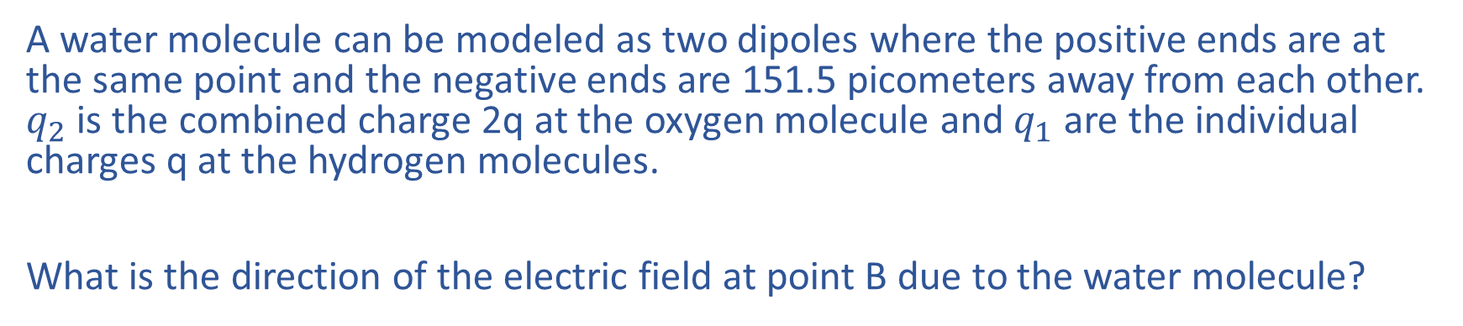
Dipole Electric Fields, Part 2
A water molecule can be modeled as two dipoles where the positive ends are at the same point and the negative ends are 151.5 picometers away from each other. $q_{2}$ is the combined charge 2q at the oxygen molecule and $q_{1}$ are the individual charges q at the hydrogen molecules.
What is the direction of the electric field at point B due to the water molecule?
Up
Down
Left
Right
Zero
95.84 pm
151.5 pm
B

Slide 14
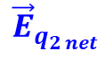
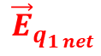
Dipole Electric Fields, Part 2
A water molecule can be modeled as two dipoles where the positive ends are at the same point and the negative ends are 151.5 picometers away from each other. $q_{2}$ is the combined charge 2q at the oxygen molecule and $q_{1}$ are the individual charges q at the hydrogen molecules.
What is the direction of the electric field at point B due to the water molecule?
Up
Down
Left
Right
Zero
95.84 pm
151.5 pm
$${\vec{E}}_{q_{2 net}}$$
B
$${\vec{E}}_{q_{1 net}}$$

Slide 15

Dipole Electric Fields, Part 3
A water molecule can be modeled as two dipoles where the positive ends are at the same point and the negative ends are 151.5 picometers away from each other. $q_{2}$ is the combined charge 2q at the oxygen molecule and $q_{1}$ are the individual charges q at the hydrogen molecules.
What is the direction of the electric field at point C due to the water molecule?
Up
Down
Left
Right
Zero
95.84 pm
151.5 pm
C

Slide 16
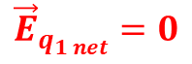

Dipole Electric Fields, Part 3
A water molecule can be modeled as two dipoles where the positive ends are at the same point and the negative ends are 151.5 picometers away from each other. $q_{2}$ is the combined charge 2q at the oxygen molecule and $q_{1}$ are the individual charges q at the hydrogen molecules.
What is the direction of the electric field at point C due to the water molecule?
Up
Down
Left
Right
Zero
95.84 pm
151.5 pm
$${\vec{E}}_{q_{2 net}}$$
$${\vec{E}}_{q_{1 net}}=0$$
C
C

Slide 17
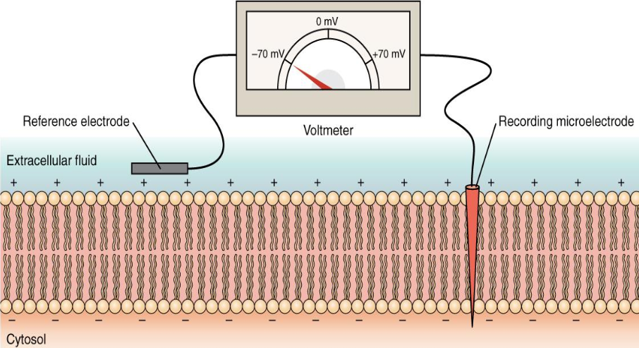
Cell Membrane Potential
Biological cells have some Electric Potential Difference as their membrane blocks the movement of some ions.
This is called “Cell Membrane Potential”.
This potential allows cells to function as a battery, giving energy to active transport mechanisms and allowing signals to be sent in cells like muscles and neurons.
This voltage plays a key role in the concentration equilibrium of ions in cells.
With our current knowledge we can determine how strongly ions will flow through the membrane
Image modified from "How neurons communicate: Figure 35.10," by OpenStax College, Biology (CC BY 4.0)._
Notes:
Might be good to talk about activation potential? Then you could turn that into a problem of “in this arrangement, will the activation potential be reached? Work along problem 03-03 could be good for capacitor? YES
The “This potential allows cells to function as a battery, giving energy to certain biological processes.” maybe give more specifics on the processes it enables or how it enables them?
Followup slide about ion flow and about how there is a chemical part about concentrations of ions which impacts how they flow across the membrane as well.
Just model it as an electron and say “yeah this is just a model to get information about how these ions would flow”.

Slide 18
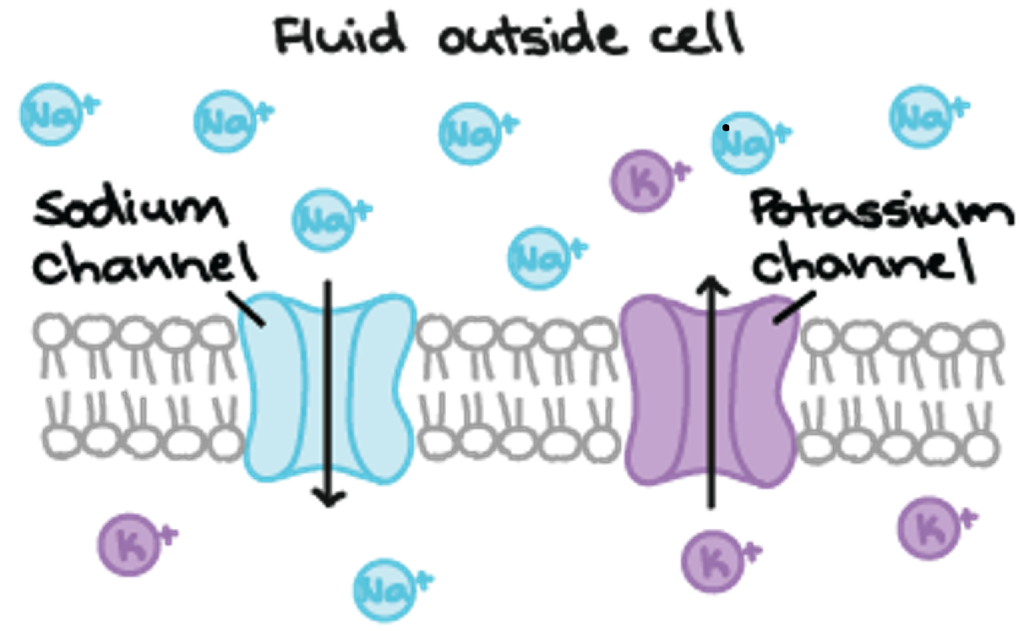
Cell Membrane Potential
The proteins inside the cell and the lower concentration relative to the sodium ions outside the cell of potassium ions cause it to be more negatively charged than the outside.
The concentration difference plays a large part in the potential.
This difference in concentration comes from the membrane not allowing passive diffusion.
Ions can only pass-through proteins that need to be activated.
Although concentration plays a large role, we will examine how the voltage impact the flow of ions through these proteins.
The channel proteins allowing sodium or potassium to pass through the membrane
Notes:
Might be good to talk about activation potential? Then you could turn that into a problem of “in this arrangement, will the activation potential be reached? Work along problem 03-03 could be good for capacitor? YES
The “This potential allows cells to function as a battery, giving energy to certain biological processes.” maybe give more specifics on the processes it enables or how it enables them?
Followup slide about ion flow and about how there is a chemical part about concentrations of ions which impacts how they flow across the membrane as well.
Just model it as an electron and say “yeah this is just a model to get information about how these ions would flow”.

Slide 19
Additional Resources
For more on the membrane potential:
https://www.khanacademy.org/science/biology/human-biology/neuron-nervous-system/a/the-membrane-potential
https://www.kenhub.com/en/library/anatomy/membrane-potential
Crash course video on electrical processes of cells:
https://www.youtube.com/watch?v=OZG8M_ldA1M
More on concentration gradients:
https://www.khanacademy.org/science/biology/membranes-and-transport/diffusion-and-osmosis/v/concentration-gradients

Slide 20
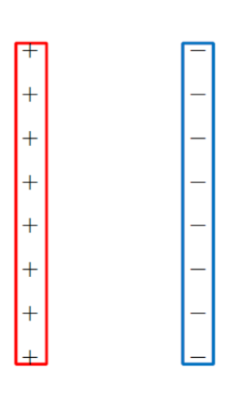
Cell Membrane Potential Problem
The inside and outside potential across a cell membrane can be modeled as two electrodes with a potential difference of ΔV = 70 mV.
A chloride ion (molar mass m = 35.45 g/mol) inside the cell membrane at the halfway point begins moving because of the potential difference. Determine the velocity of the ion as it collides with the cell wall.

Slide 21
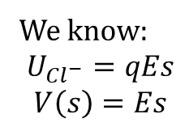
Cell Membrane Potential Problem
The inside and outside potential across a cell membrane can be modeled as two electrodes with a potential difference of ΔV = 70 mV.
A chloride ion (molar mass m = 35.45 g/mol) inside the cell membrane at the halfway point begins moving because of the potential difference. What would be the potential energy of this ion?
We know:
$$U_{Cl^{−}}=qEs$$
$$V\left(s\right)=Es$$
$U_{Cl^{−}}=qV=eV=1.6∗{10}^{−19}C∗\frac{70mV}{2}=5.6∗{10}^{−21}$J
So, we can use what we know right now to get important information about this system!

Slide 22
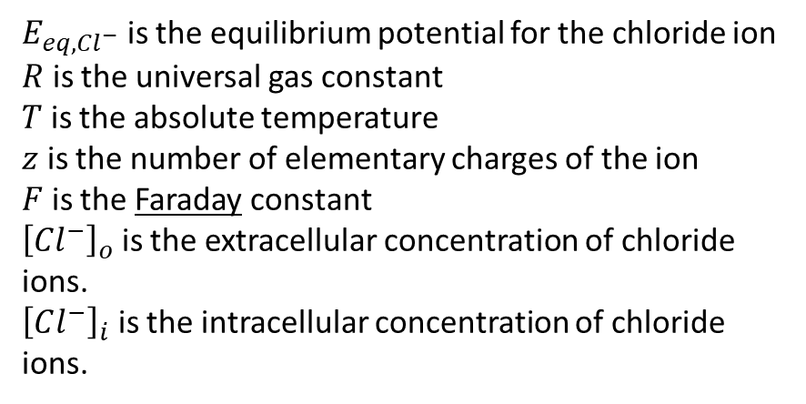
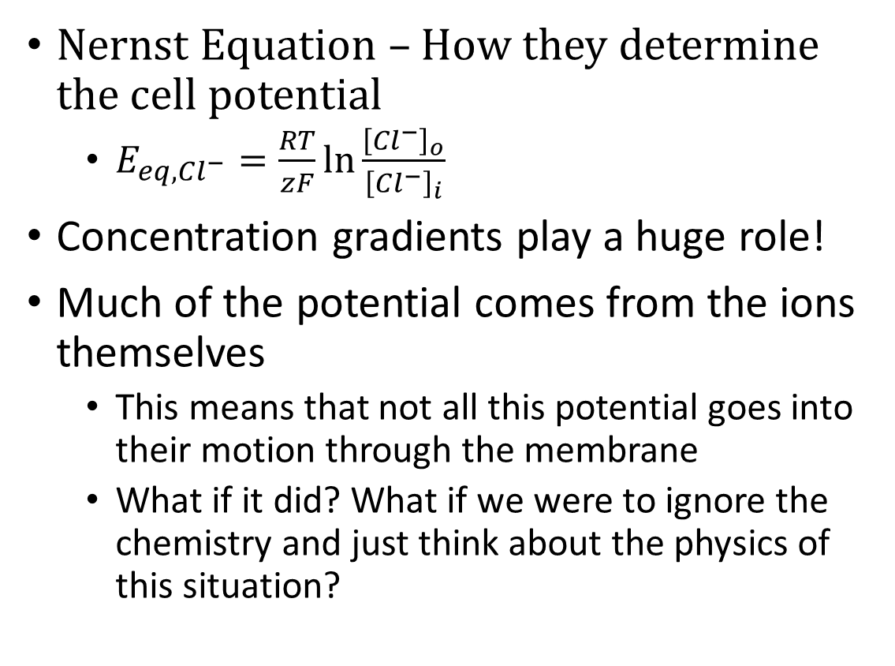
Physics Isn't everything
Nernst Equation – How they determine the cell potential
$E_{eq,Cl^{−}}=\frac{RT}{zF}\ln{\frac{{\left[{Cl}^{−}\right]}_{o}}{{\left[Cl^{−}\right]}_{i}}}$
Concentration gradients play a huge role!
Much of the potential comes from the ions themselves
This means that not all this potential goes into their motion through the membrane
What if it did? What if we were to ignore the chemistry and just think about the physics of this situation?
$E_{eq,Cl^{−}}$ is the equilibrium potential for the chloride ion
$R$ is the universal gas constant
$T$ is the absolute temperature
$z$ is the number of elementary charges of the ion
$F$ is the Faraday constant
${\left[{Cl}^{−}\right]}_{o}$ is the extracellular concentration of chloride ions.
${\left[Cl^{−}\right]}_{i}$ is the intracellular concentration of chloride ions.

Slide 23
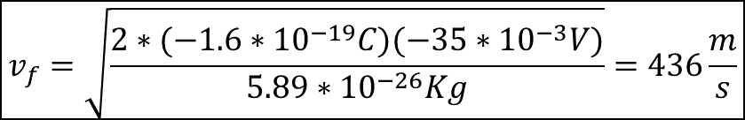
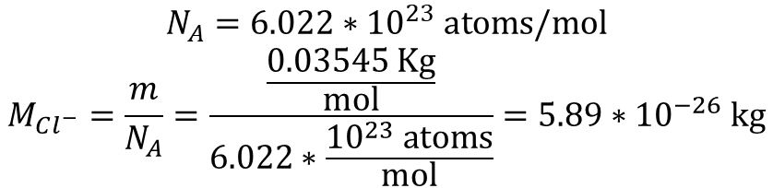
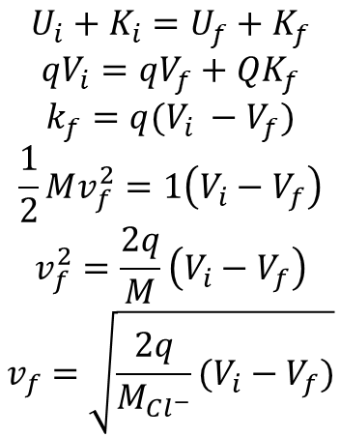
Cell Membrane Potential Problem
The inside and outside potential across a cell membrane can be modeled as two electrodes with a potential difference of ΔV = 70 mV.
A chloride ion (molar mass m = 35.45 g/mol) inside the cell membrane at the halfway point begins moving because of the potential difference. Determine the velocity of the ion as it collides with the cell wall.
$$U_{i}+K_{i}=U_{f}+K_{f}$$
$$qV_{i}=qV_{f}+QK_{f}$$
$$k_{f}=q(V_{i} −V_{f})$$
$$\frac{1}{2}Mv_{f}^{2}=1\left(V_{i}−V_{f}\right)$$
$$v_{f}^{2}=\frac{2q}{M}\left(V_{i}−V_{f}\right)$$
$$v_{f}=\sqrt{\frac{2q}{M_{Cl^{−}}}(V_{i}−V_{f})}$$
$$V_{i}−V_{f}=35\text{mV} −70\text{mV}=−35∗{10}^{−3}\text{V}$$
$$v_{f}=\sqrt{\frac{2∗(−1.6∗{10}^{−19}C)(−35∗{10}^{−3}V)}{5.89∗{10}^{−26}Kg}}=436\frac{m}{s}$$
In reality, the ions velocity as it would collide or pass through the cell membrane would be a speed of about 0.05 m/s. So, although physics does play a huge role in this process, it can not fully describe it. It is only through a combination of both chemistry and physics that this biological process can be fully explained.
$$N_{A}=6.022∗{10}^{23} \text{atoms}\text{/}\text{mol}$$
$$M_{Cl^{−}}=\frac{m}{N_{A}}=\frac{\frac{0.03545 \text{Kg}}{\text{mol}}}{6.022∗\frac{{10}^{23} \text{atoms}}{\text{mol}}}=5.89∗{10}^{−26} \text{kg}$$

Slide 24
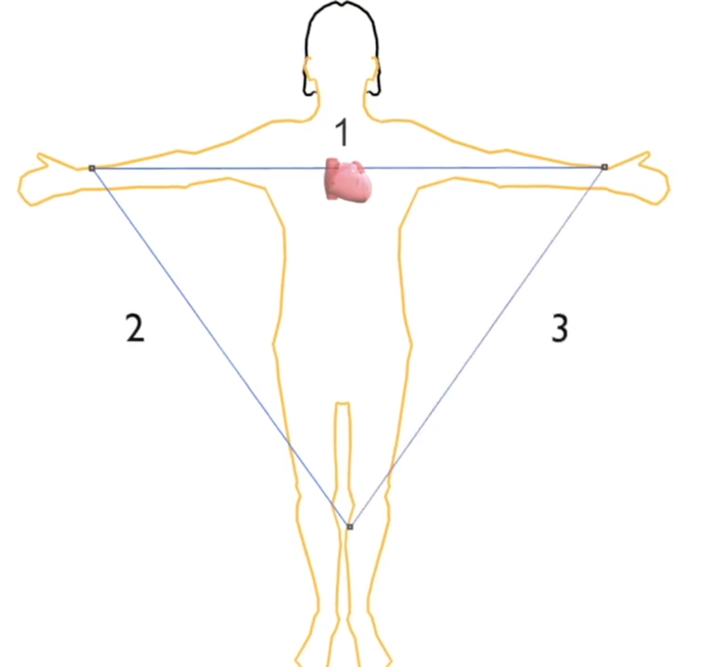
Electrocardiography
An Electrocardiogram, (ECG), is a way to visualize how electricity moves through the heart by placing measuring leads at specific spots on the body.
As muscles are cells, they have some membrane potential when they are at rest. A wave of positive charge depolarizes the membrane causing each heartbeat.
This “Depolarization Wave” is what is of most interest in an ECG.
Diagram depicting the placement of the main leads where the voltage measurements will be taken from
Notes:
New diagram that is sim mpler

Slide 25
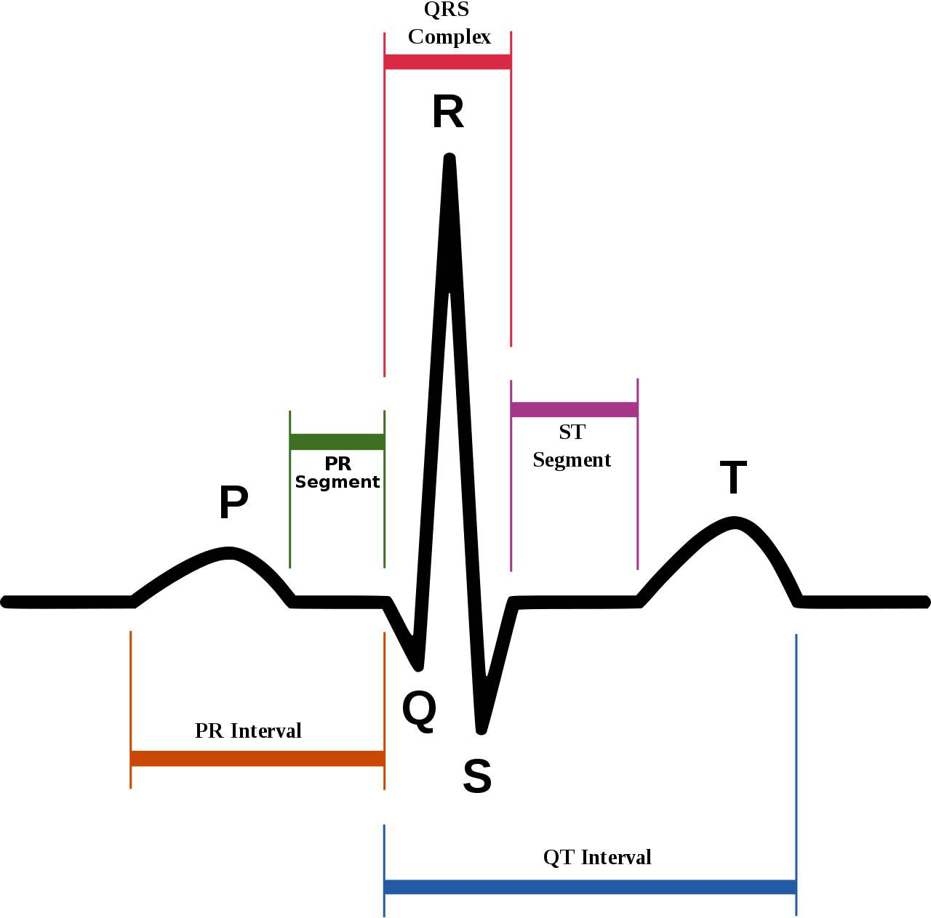
Electrocardiography
During the depolarization of the cells (the beat of the heart) there is an instantaneous dipole created. This dipole voltage is what the ECG measures through how much the signal from the leads is deflected.
The ECG spike magnitude is directly related to the voltage of the dipole created.
Anthony Atkielski / Public Domain
Notes:
For the problem, it might be good to make a problem about how much the signal would deflect based on modelling the depolarization wave as point charges. – work along problem 04.01 – could make an add on to 04.01 where you actually calculate the potential difference etc. – because it’s a dipole wave that gets generated that causes the deflection. Could adapt this problem to be about finding the electric potential and how much a signal would be deflected because of it.
Calculating the potential difference given the charges. (better)
Or calculate the charges gfiven the potential difference.

Slide 26
Additional Resources
Some videos on the basics of ECG’s and how they work
https://www.youtube.com/watch?v=xIZQRjkwV9Q
https://www.youtube.com/watch?v=C35Lq2vntzU
The Wikipedia page on ECG’s
https://en.wikipedia.org/wiki/Electrocardiography
A very in depth explanation of the biochemistry and biophysics behind an ECG.
https://www.mit.edu/~gari/ecgbook/ch1.pdf

Slide 27
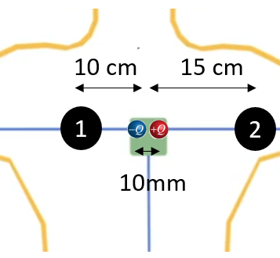
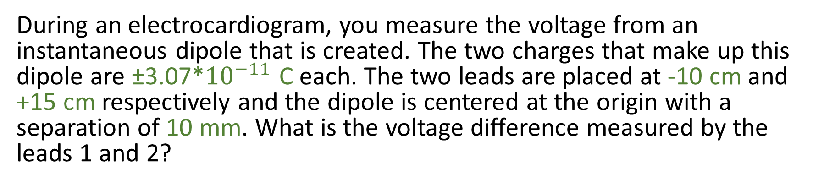
Electrocardiography Problem
During an electrocardiogram, you measure the voltage from an instantaneous dipole that is created. The two charges that make up this dipole are ±3.07*${10}^{−11}$ C each. The two leads are placed at -10 cm and +15 cm respectively and the dipole is centered at the origin with a separation of 10 mm. What is the voltage difference measured by the leads 1 and 2?

Slide 28
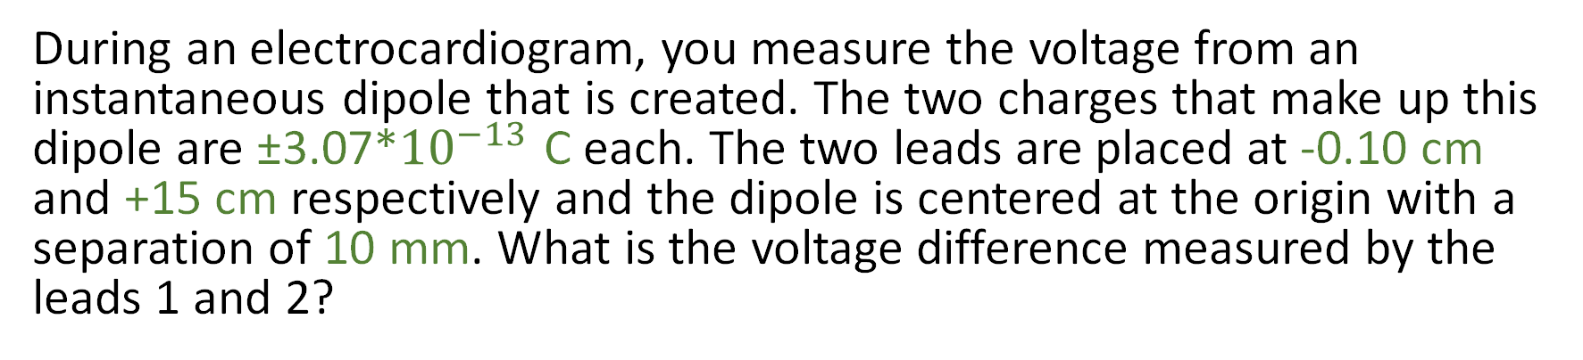
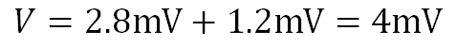
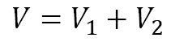
Electrocardiography Problem
During an electrocardiogram, you measure the voltage from an instantaneous dipole that is created. The two charges that make up this dipole are ±3.07*${10}^{−13}$ C each. The two leads are placed at -0.10 cm and +15 cm respectively and the dipole is centered at the origin with a separation of 10 mm. What is the voltage difference measured by the leads 1 and 2?
$$V=V_{1}+V_{2}$$
$V_{1}=\frac{KQ}{r_{11}}+\frac{K\left(−Q\right)}{r_{12}}$ $=\frac{(8.99∗{10}^{9}Nm^{2}/C^{2})(3.07∗{10}^{−13}C)}{−0.105m}+\frac{(8.99∗{10}^{9}Nm^{2}/C^{2})\left(−3.07∗{10}^{−13}C\right)}{−0.095m}=2.8mV$
$V_{2}=\frac{KQ}{r_{21}}+\frac{K\left(−Q\right)}{r_{22}}$ = $\frac{(8.99∗{10}^{9}Nm^{2}/C^{2})(3.07∗{10}^{−13}C)}{0.145m}+\frac{(8.99∗{10}^{9}Nm^{2}/C^{2})\left(−3.07∗{10}^{−13}C\right)}{0.155m}=1.2mV$
$$V=2.8mV+1.2mV=4mV$$
This amount of voltage is a very standard amount for ECG spike readings.

Slide 29
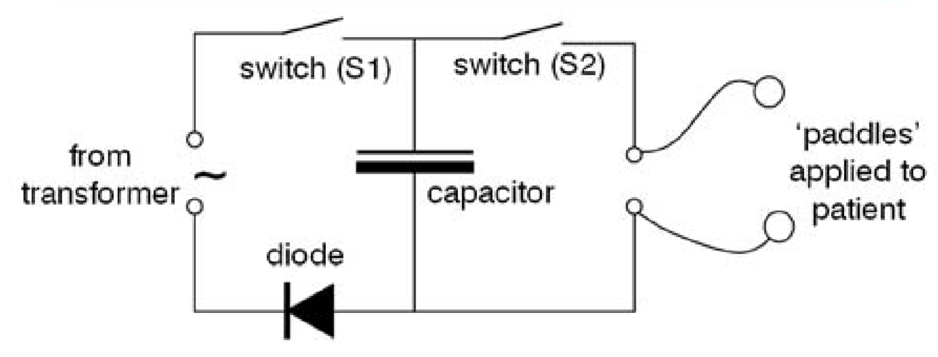
Defibrillation
Defibrillators can be used to help the heart regain its rhythm if it has been disturbed.
Defibrillators require a large voltage to work, and many must be easily transportable and must rely on batteries.
Capacitors are used to create a large voltage from a weak power source like a battery.
The large voltage shock from a defibrillator depolarizes the heart and allows it to begin beating normally again.
Circuit diagram of the basic components of a defibrillator. The transformer acts as the power source or battery.
Notes:
Might be good to talk about activation potential? Then you could turn that into a problem of “in this arrangement, will the activation potential be reached? Work along problem 03-03 could be good for capacitor? YES
The “This potential allows cells to function as a battery, giving energy to certain biological processes.” maybe give more specifics on the processes it enables or how it enables them?
Followup slide about ion flow and about how there is a chemical part about concentrations of ions which impacts how they flow across the membrane as well.
Just model it as an electron and say “yeah this is just a model to get information about how these ions would flow”.

Slide 30
For exactly how a defibrillator works:
https://www.howequipmentworks.com/defibrillator/
http://sta.ie/perch/resources/lessons/a4bslessoned.7.pdf

Slide 31
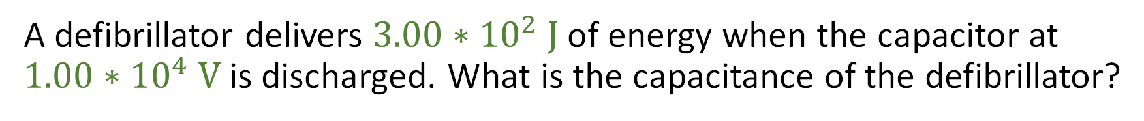
Defibrillation Problem
A defibrillator delivers $3.00∗{10}^{2} \text{J}$ of energy when the capacitor at $1.00∗{10}^{4} \text{V}$is discharged. What is the capacitance of the defibrillator?

Slide 32
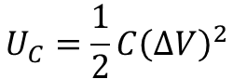

Defibrillation Problem
A defibrillator delivers $3.00∗{10}^{2} \text{J}$ of energy when the capacitor at $1.00∗{10}^{4} \text{V}$is discharged. What is the capacitance of the defibrillator?
$$U_{C}=\frac{1}{2}C{\left(∆V\right)}^{2}$$
$$C=\frac{2U_{C}}{∆V^{2}}=\frac{2∗3.00∗{10}^{2}J}{{\left(1∗{10}^{4}\right)}^{2}}=6∗{10}^{−6}=6μF$$

Slide 33

Defibrillation Problem
A$10 \text{μ}\text{F}$ capacitor of a defibrillator is charged to $9.00 ∗{10}^{3} \text{V}\text{.}$
How much energy is stored in this capacitor?
How much charge is stored up to create this voltage?

Slide 34


Defibrillation Problem
A$10 \text{μ}\text{F}$ capacitor of a defibrillator is charged to $9.00 ∗{10}^{3} \text{V}\text{.}$
How much energy is stored in this capacitor?
$$U_{C}=\frac{1}{2}C{\left(∆V\right)}^{2}=\frac{1}{2}\left(10 μF\right)∗{\left(9.00∗{10}^{3}V\right)}^{2}=405 J$$

Slide 35


Defibrillation Problem
A$10 \text{μ}\text{F}$ capacitor of a defibrillator is charged to $9.00 ∗{10}^{3} \text{V}\text{.}$
How much charge is stored up to create this voltage?
$$U_{C}=\frac{Q^{2}}{2C}$$
$$Q=\sqrt{2CU_{C}}= \sqrt{2∗10μF∗405J}=90 mC$$

